Slide 1

The Giving Graph
Mining the web for fun and nonprofits
The Eric & Wendy Schmidt
Data Science for Social Good
Summer Fellowship 2013

Slide 2






Slide 3

“Which companies might support me?”
“Which companies support nonprofits similar to me?”

Slide 4




Similar
Similar
$
$
$
$
$$
$
$
“Which companies support nonprofits similar to me?”

Slide 5


Finding Similar Nonprofits
Mission Statements
“To bring dogs into the home and family from a chained or penned existence. Three aspects of societal needs are addressed to accomplish this mission: Education, …”
“…to help them into education and employment, through the provision of specially trained dogs…”

Slide 6


Finding Similar Nonprofits
Twitter Followers
@LadyLuna7
@keepmefromharm

Slide 7
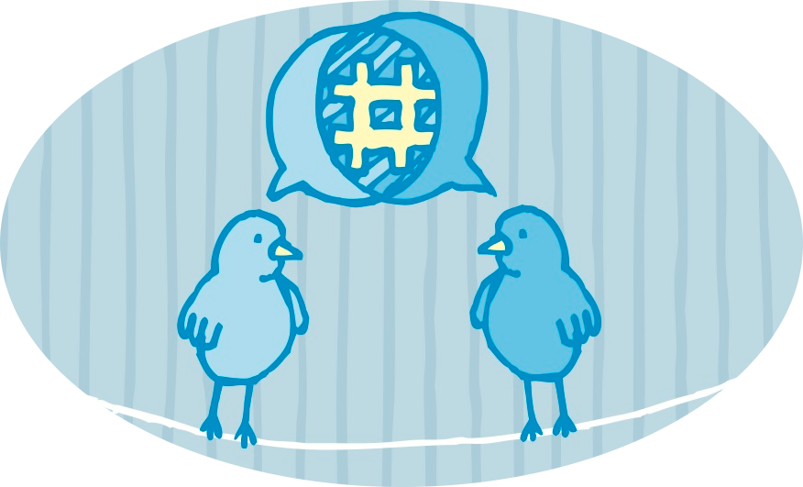
Finding Similar Nonprofits
Tweets

Slide 8
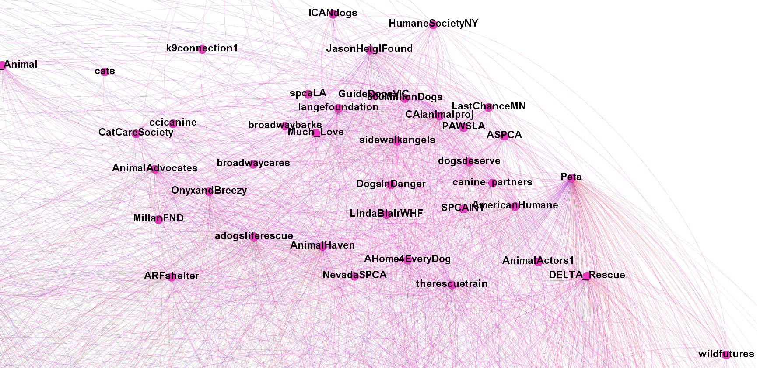
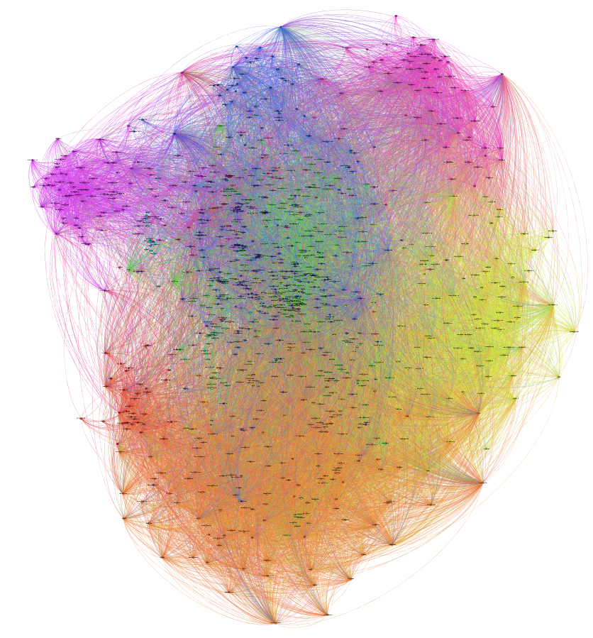
Animals

Slide 9
Animals
Cancer
Autism
Diabetes
Parkinson’s
Organs
Environment
Music
HIV/AIDS
Gay Rights
Human Rights
Trafficking

Slide 10
Similar
Similar
$
$
$
$
$
$
$
$

Slide 11

Corporate Support
News article: “…Canine Partners 5K, sponsored by 3M…”
PETA’s web page: “…PETA Business Friend Native Foods Cafe…”

Slide 12
Future Work
Non-profit collaboration
Who should I write a grant with?
Branding
How is the language I use similar or different from the language used by other nonprofits?
Board Members
Who am I connected to at other nonprofits or companies?

Slide 13
END

Slide 14




Giving
Graph

Slide 15
The Giving Graph
Nonprofits
Companies
Individuals
Causes

Slide 16
Finding Similar Nonprofits
Using NTEE codes
Using Text Analysis
Dogs Deserve Better
Wild Animal Sanctuary
Romanian League in Defense of Animals
Dogs Deserve Better
Canine Partners
PETA
600Million.org

